Slide 1
CSS-429 – Final project
Predicting GDP per capita of countries

Slide 2
Team 7 – Abraca-data
Muratbekov Maksatbek
Sarkulov Yerden
Tolbassy Bakdaulet
Yegemberdi Nurgeldi
Zhakypov Aslan

Slide 3

BUSINESS UNDERSTANDING
Suppose our team works as the Agency for Economic Development of Kazakhstan. Hence, it is important for us to forecast GDP per capita in order to develop the country's economy and plan for the next year in various economic sectors of the country. GDP per capita is an important indicator of economic performance and a useful unit to make cross-country comparisons of average living standards and economic wellbeing.

Slide 4
Dataset
We used the Countries of the World dataset from Kaggle (link: https://www.kaggle.com/fernandol/countries-of-the-world)
Columns: Country, Region, Population, Area, Pop. Density (per sq. mi.), Coastline (coast/area ratio), Net migration, Infant mortality (per 1000 births), GDP ($ per capita), Literacy (%), Phones (per 1000), Arable (%), Crops (%), Other (%), Climate, Birthrate, Deathrate, Agriculture, Industry, Service.

Slide 5
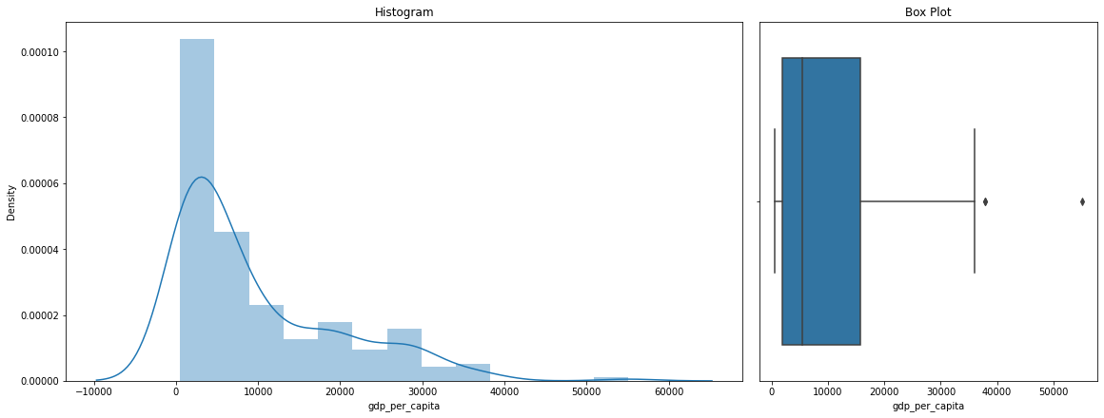
Data Visualizations
Target variable analysis:
Our target variable, GDP per Capita is not normally distributed.
Our target variable is right-skewed.
There are 2 outliers in the variable

Slide 6
Correlation heatmap
Strong Correlations:
there is a strong positive correlation between gdp per capita and phones (0.83)
there is a strong positive correlation between infant mortality and birthrate (0.84)
there is a strong negative correlation between literacy and birthrate (-0.78)
there is a strong negative correlation between literacy and infant motality (-0.75)
there is a strong negative correlation between birthrate and phones (-0.72)
there is a strong negative correlation between other and arable (-0.73)

Slide 7
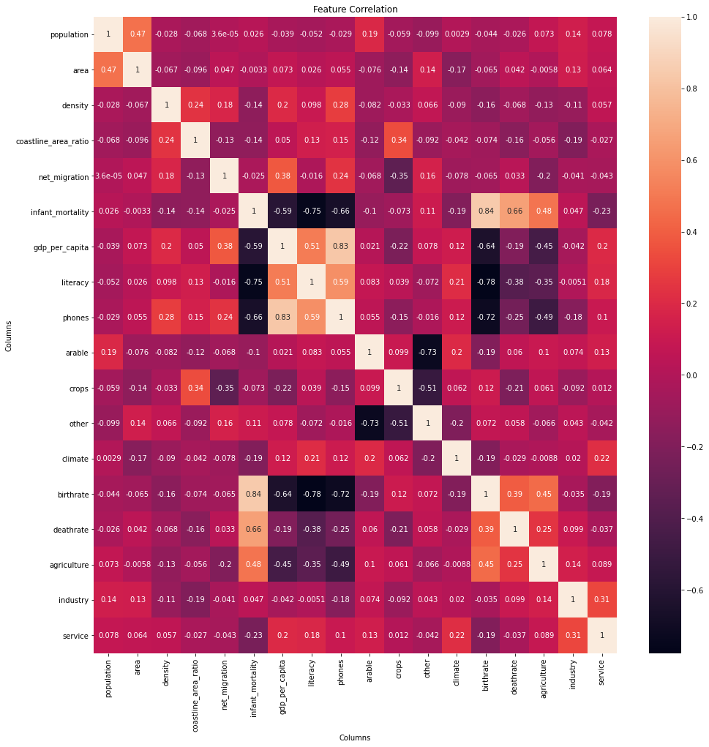

Slide 8
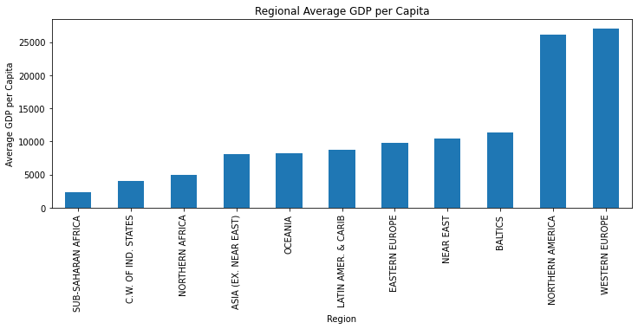
Data Visualizations

Slide 9
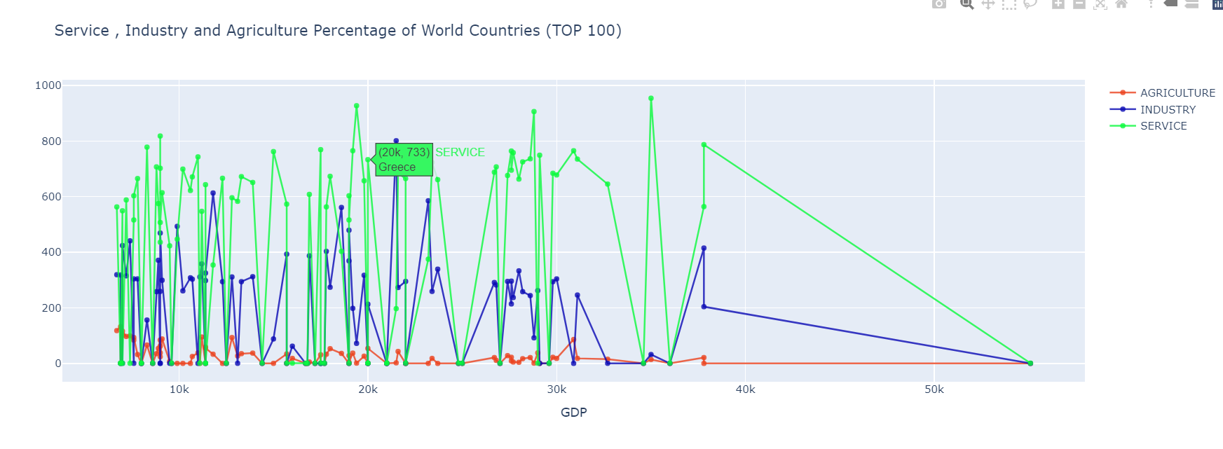
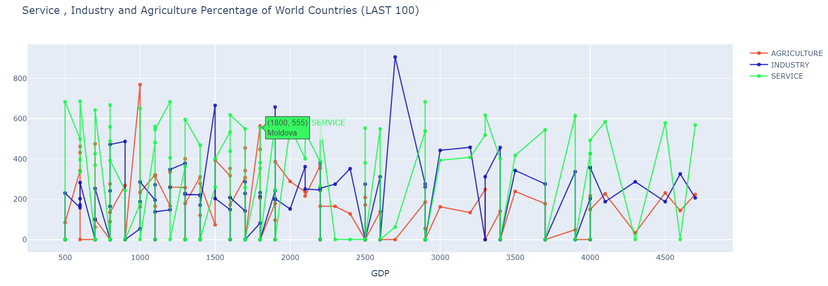
World Stats
The top 100 countries have a very high service percentage (averaged at around 70%) and a very low agriculture percentage (averaged at around 3%) whereas the bottom 100 countries have a lower service percentage, in relation with the top 100 countries (averaged at around 43%) and a higher agriculture percentage (averaged at around 22%).

Slide 10
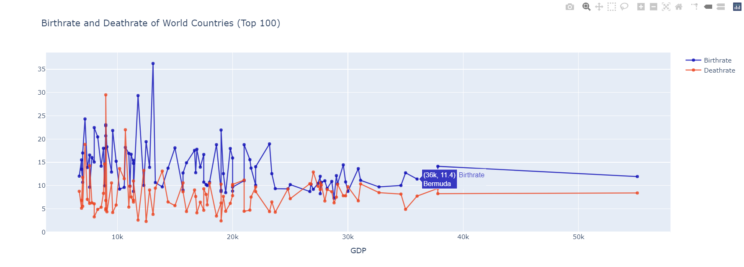
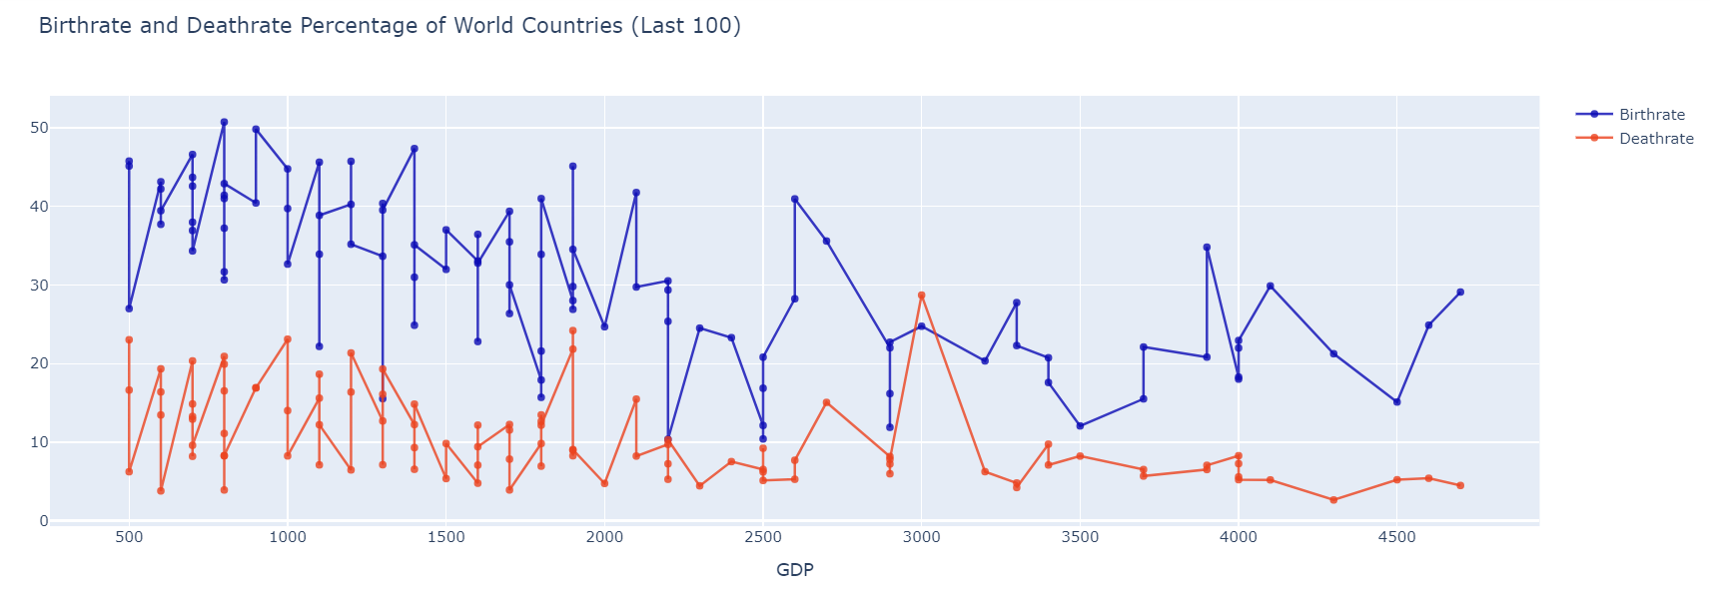
World Stats
As predicted, when GDP decreases, both Birthrate and death rate increases.

Slide 11
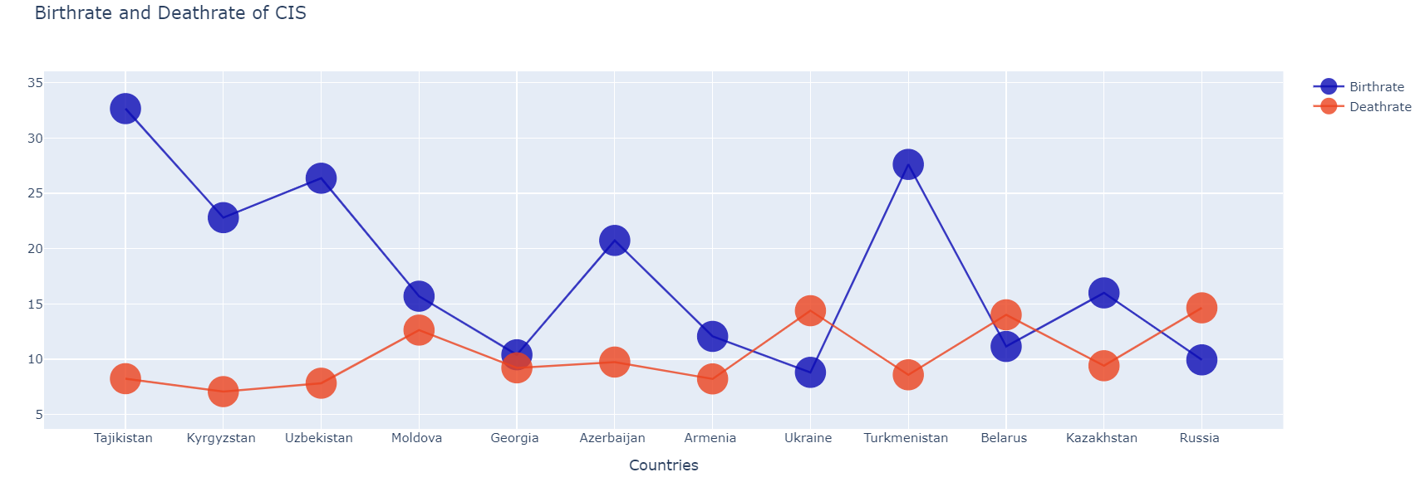
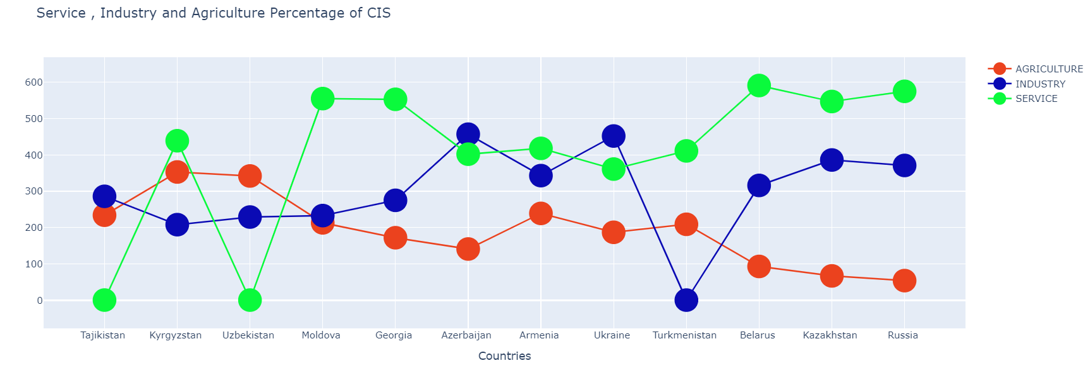
CIS

Slide 12
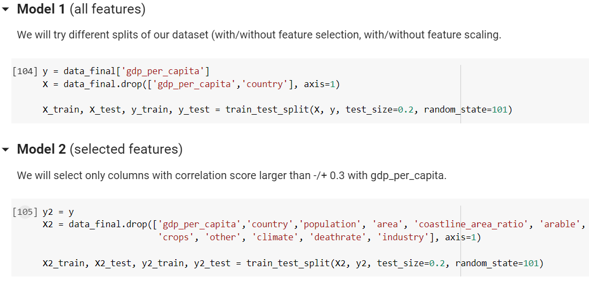
Modelling

Slide 13
Modelling
Linear Regression:
This was our baseline model, we used the result as a reference to compare with others. We could see that most features do not have a linear relationship with our labels (gdp_per_capita), yet we tried linear regression.
Lasso Regression
Random Forest:
We used this model because it is robust to outliers, works well with non-linear data. It has lower risk of overfitting and better accuracy than other algorithms.

Slide 14
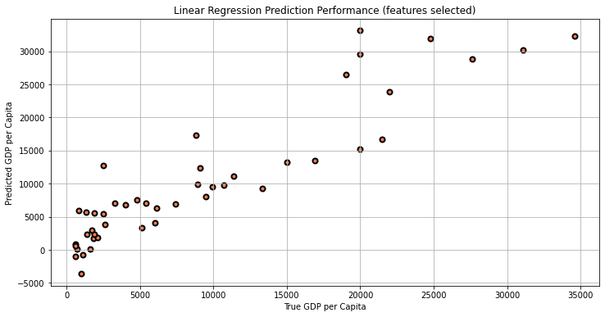
Evaluation
Linear Regression:
all features:
MAE: 373268.60793178563
RMSE: 1776237.7539696244
R2_Score: -38182.43082897876
selected features:
MAE: 2921.00540806377
RMSE: 4143.149069688224
R2_Score: 0.7922534247797287

Slide 15
Evaluation
Lasso Regression:
with selected features
MAE: 2921.0276000001822
RMSE: 4143.17544919213
R2_Score: 0.7922507793190192

Slide 16
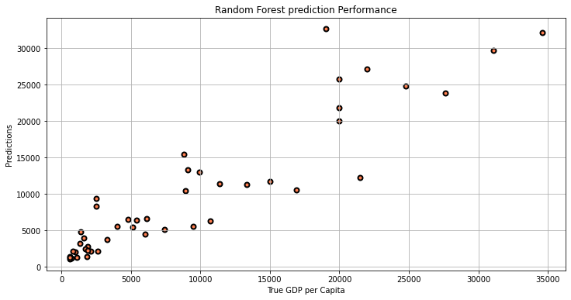
Evaluation
Random Forest:
with all features
MAE: 2529.141304347826
RMSE: 3732.061477923428
R2_Score: 0.8314338636336989
with selected features
MAE: 2763.391304347826
RMSE: 4026.1710718746167
R2_Score: 0.8038188832529698

Slide 17

Predicting GDP of Kazakhstan
True GDP per capita of Kazakhstan is 6300$
The GDP per capita of Kazakhstan is predicted as 6466$ by the best regressor which used all features of Countries of the World dataset.

Slide 18
DEPLOYMENT
This result can be used to understand how the economy is growing with population. GDP per capita analysis on a national level can provide insights on a country’s domestic population influence. By this model we can predict our GDP for the next year inputting new data and create new useful reforms.

